Slide 1
Lab 05 Utilizing Resources and Media
By
M.Zakir Khan

Slide 2
Resources include text data, bitmaps, audio, videos and other items used by the Android application. Resources in android refer to the external files that hold the information such as strings, images, layouts and audio, to be supplied to an Android application Because resources are external and we can maintain and modify them whenever we want without disturbing the code.

Slide 3
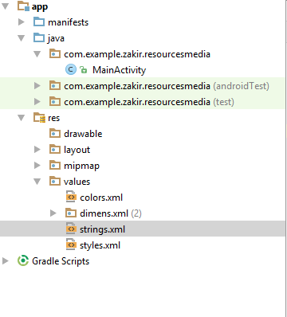
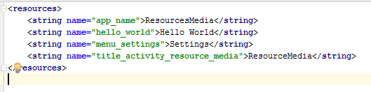
Default code in string.xml file

Slide 4
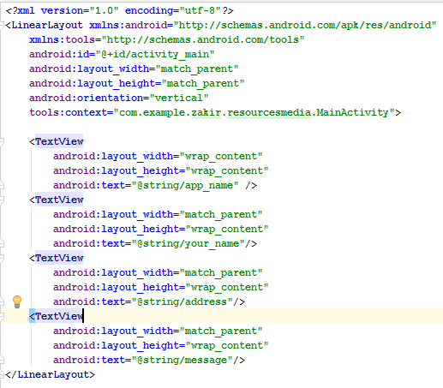
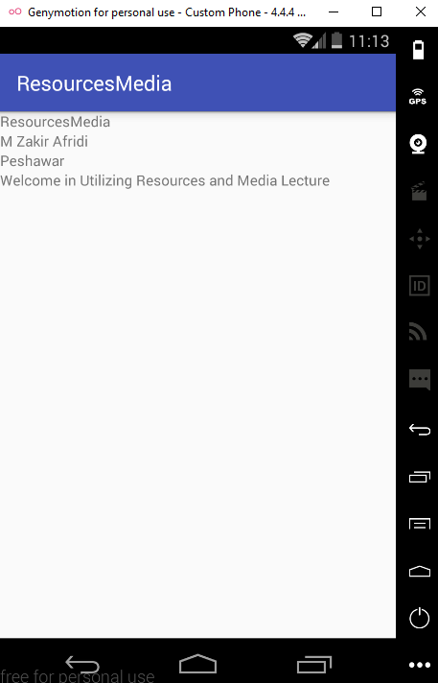
XML CODE and Layout View

Slide 5
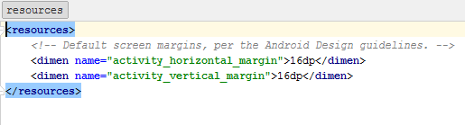
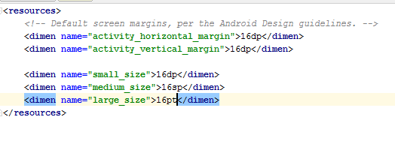
Dimension Resources Default dimension.xml file
Dimension resources are used for standardizing certain application measurement. These resources can be used to specify the sizes for fonts, layouts and widgets. Also we can modify the size of any control in the application without changing the code.
Px ---- pixels
In --- inches
Mm--- millimeter
Pt ---- Points
Dp --- Density independent pixels
Sp --- Scale Independent pixels

Slide 6
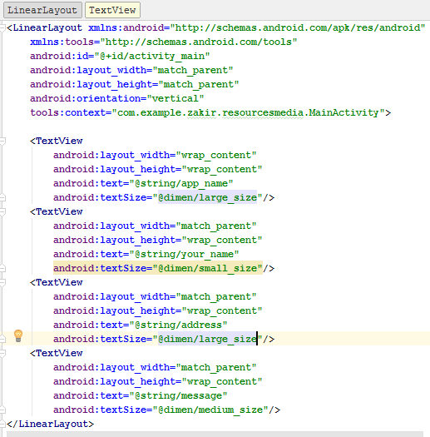
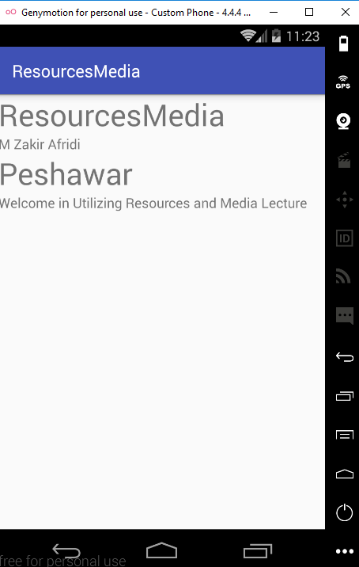
XML CODE and Layout View

Slide 7
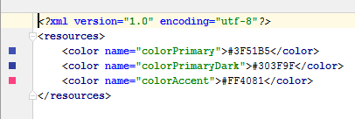
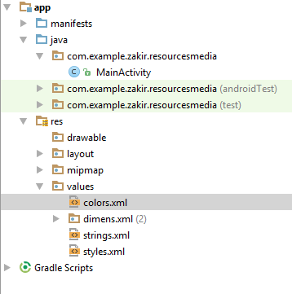
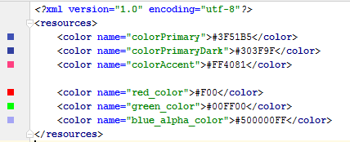
Color Resources color.xml file
To define a color resources, we use the color element. The color value is specified in the form of hexadecimal RGB.
#RGB for example #F00 for a Red color
#RRGGBB for example #FF0000 for a red color
#ARGB for example #5F00 for a Red color with alpha of 5

Slide 8
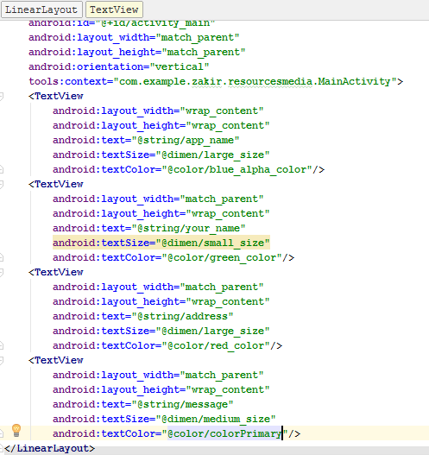
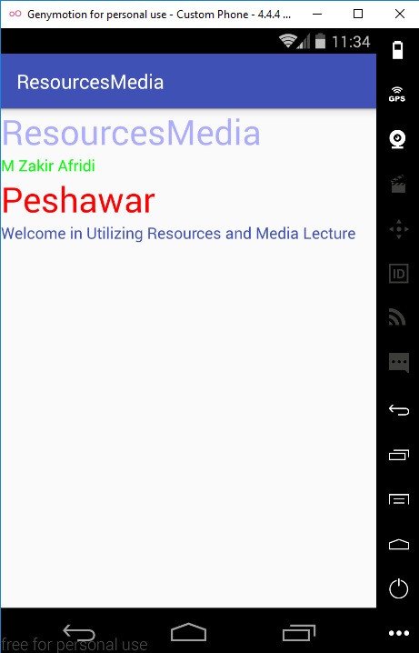
XML CODE and Layout View

Slide 9
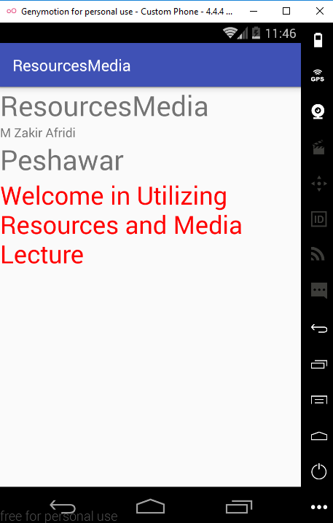
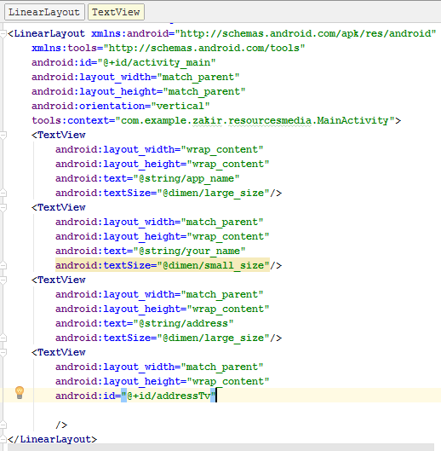
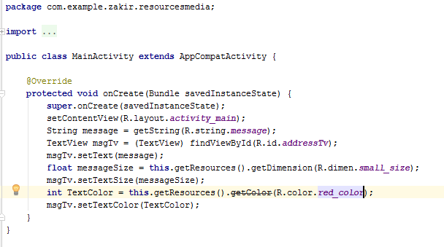
Applying color, textSize and getString through Java file

Slide 10
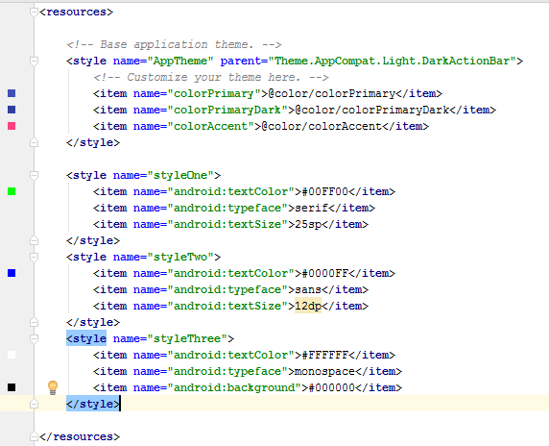
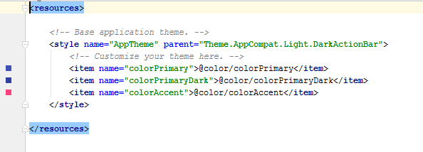
Style and Theme
A style is the collection of attributes such as color, font, margin and padding that we can apply collectively to our views

Slide 11
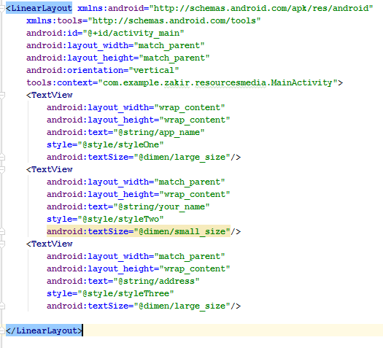
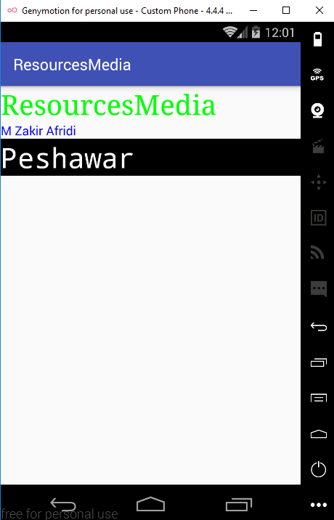
XML and Layout View

Slide 12

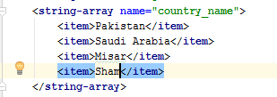
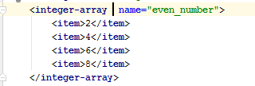
String Array
As the name suggests, the string array provides an array of strings. Such a resources is popularity used with selection widgets such as Listview and Spinner that need the collection of selectable items to the user.
To define the array we use the following syntax:

Slide 13
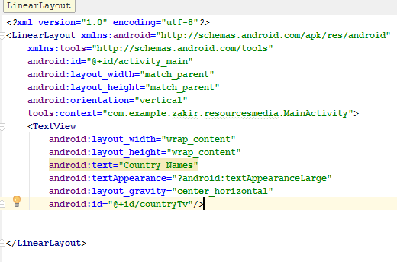
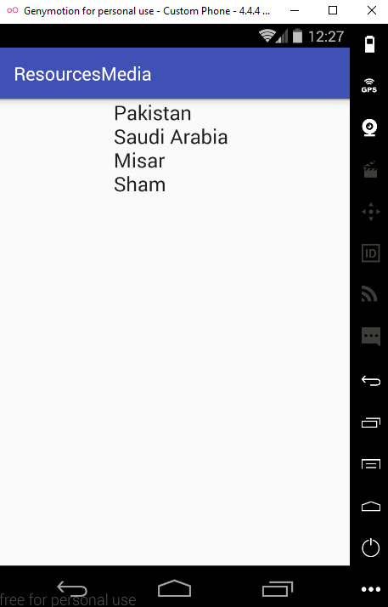
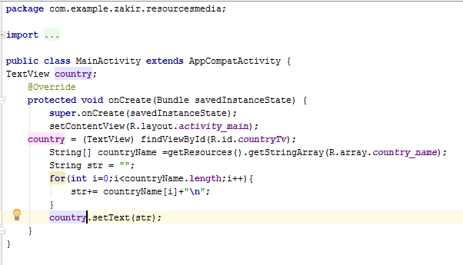
Example on String Array

Slide 14

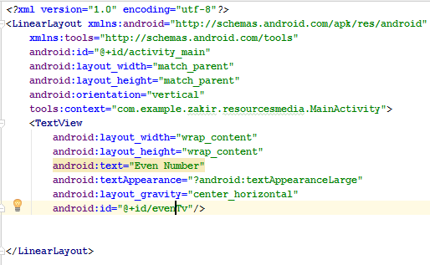
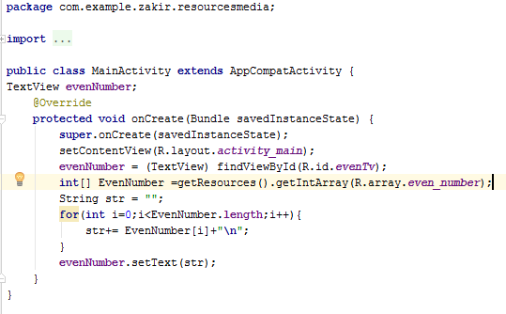
Example on IntegerArray

Slide 15
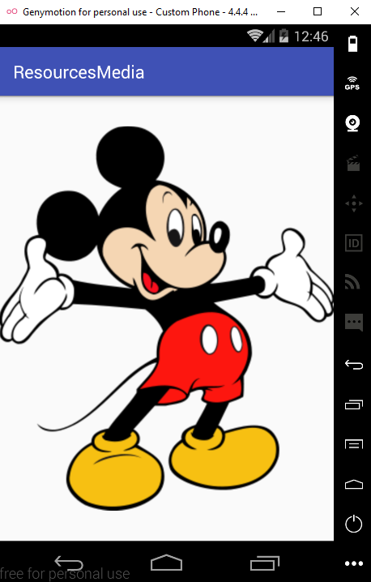
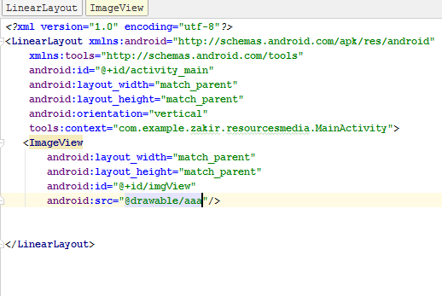
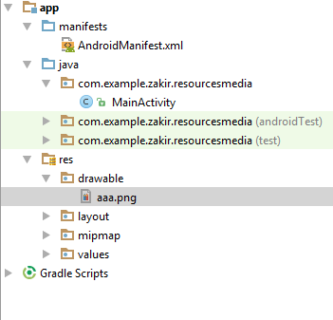
Using Drawable Resources

Slide 16
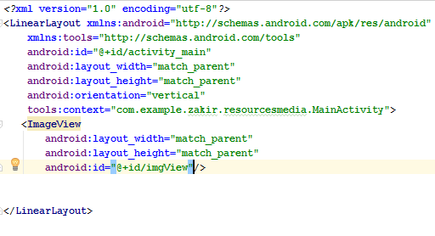
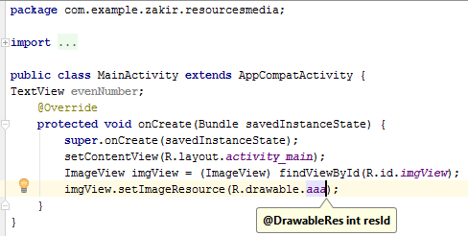
Using Java Code

Slide 17
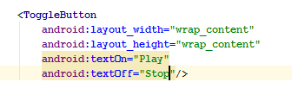
Switching States with Toggle Buttons
As from the name suggest that Toggle Button toggles between the two states something like a radio button
A toggle button can only be on one state out of two mutually exclusive states. For example On and Off
To display a toggle button , we use <ToggleButton> tag.

Slide 18
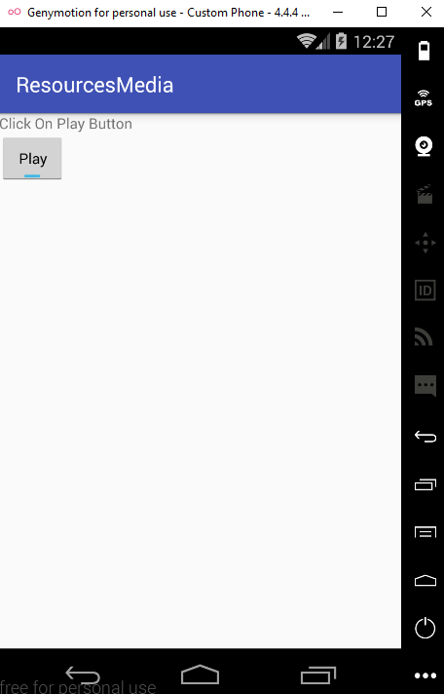



Slide 19
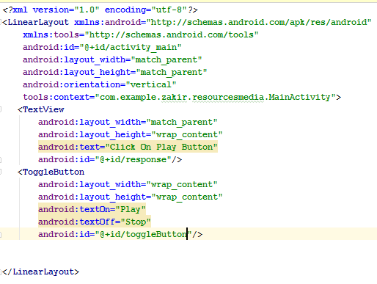
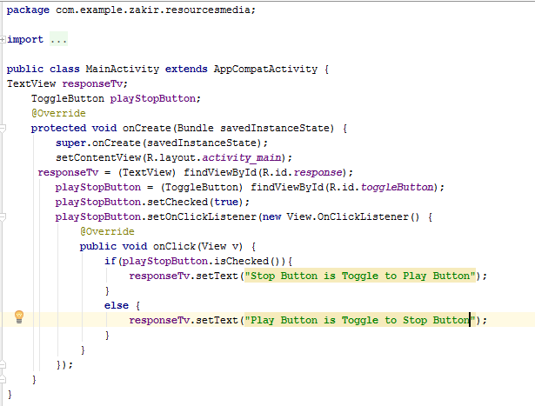
XML Code and Java Code

Slide 20
Creating Image Switcher Application
We just learnt how the ToggleButton works, so lets use it to modify our earlier application of imageView into image switcher application.
On startup, this application initially displays an image through Imageview control with a toggleButton at the bottom of the screen.
Image will change when toggleButton click
Note
Do not copy the image direct into drawable folder copy otherwise the effect will be like in the Next Slide
Make the image in xhdpi,hdpi,mhdpi etc and then paste

Slide 21
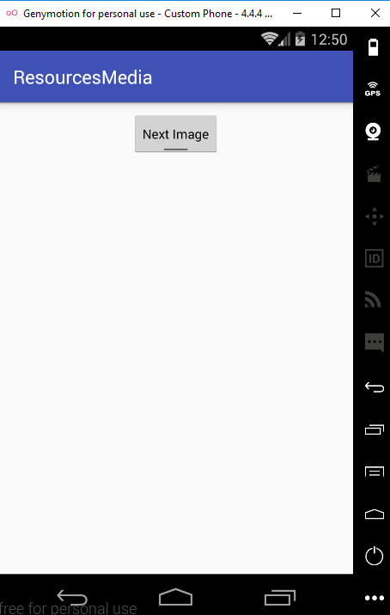
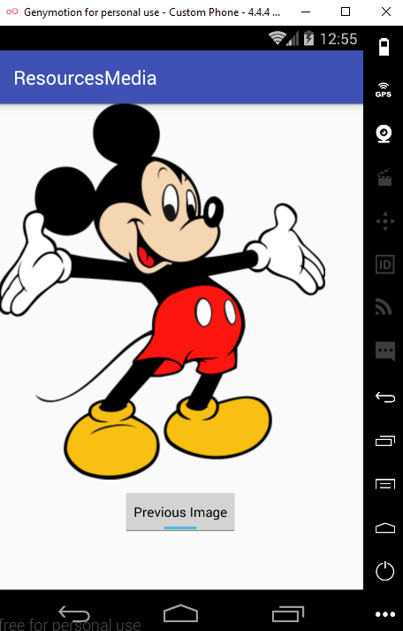
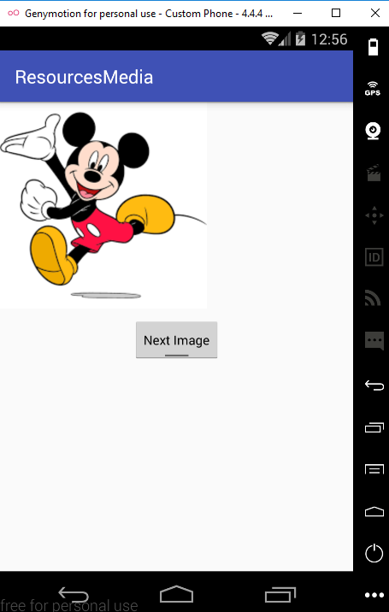

Slide 22
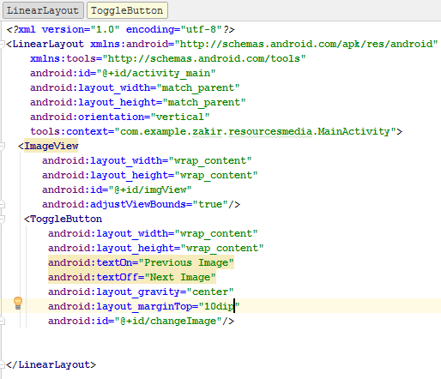
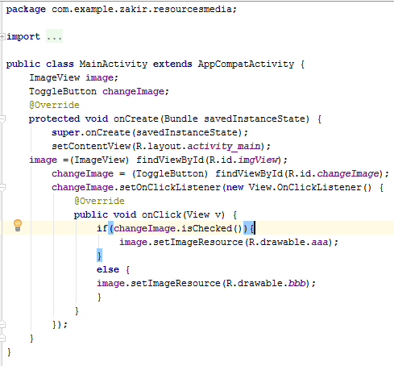
XML Code and Java Code

Slide 23
Scrolling through ScrollView
A scrollview is a special type of control that set up a vertical scrollbar in a view controller.
This control is used when we try to display Views that are too long to be accommodated in a single screen.
The scrollview can have only one child view, so usually a view container layout is used as a child when in turn contains other child controls that we want to scroll through.
Note
To display images on devices of different sizes and resolutions and to ensure that your app looks great on any device, the 96*96px, 72*72px, 48*48px and 36*36px images with resolutions of 320 dpi, 240dpi,160dpi and 120dpi respectively are copied into the res/drawable-xhdpi, res/drawable-hdpi, res/drawable-xhdpi folders respectively

Slide 24
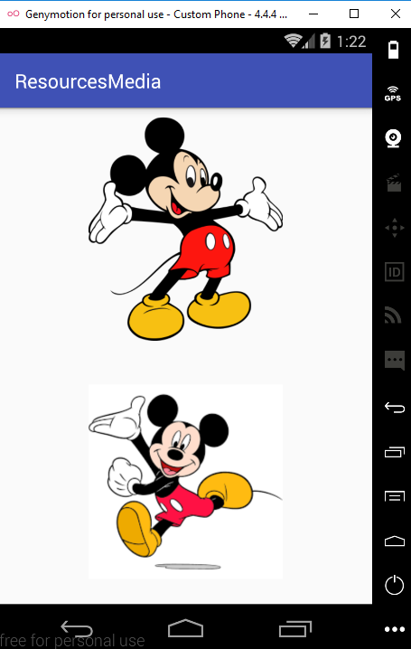
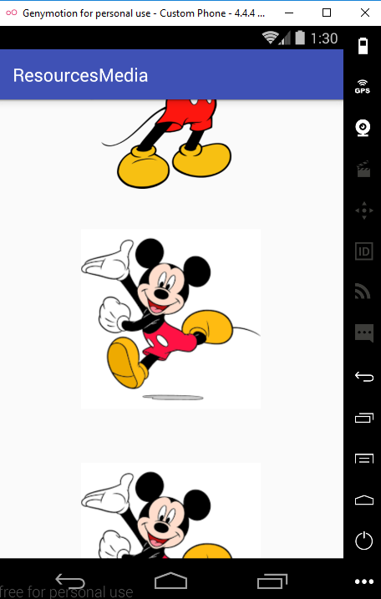
Without using fillViewport=“true” in <ScrollView> then it would look like in left below.

Slide 25
Playing Audio
We will learn how to play audio and the method used to pause and resume the audio.
First of All adding Audio to the Application
the audio file that we want to play must be located in the res/raw folder of our application. The raw folder is not created automatically so we need to create it manually.
Right click the res folder in the package Explorer window and select New Folder. A dialogue box will open enter the name of the new folder as raw and click the finish button

Slide 26
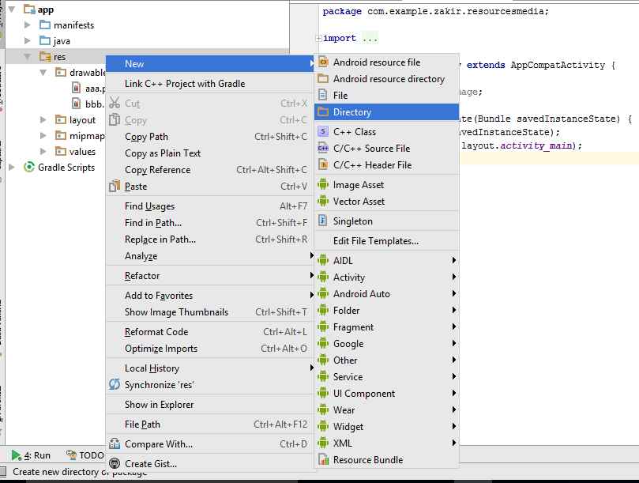
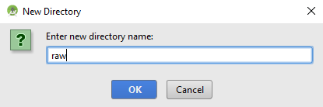
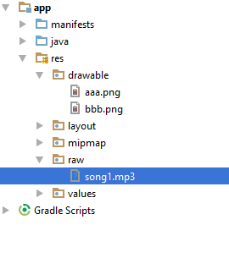

Slide 27
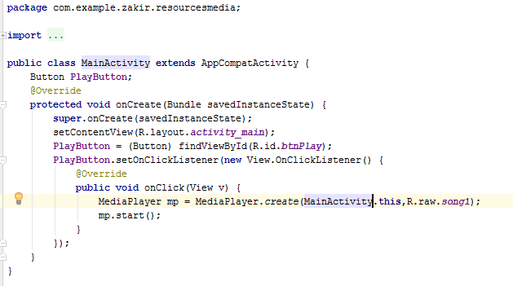
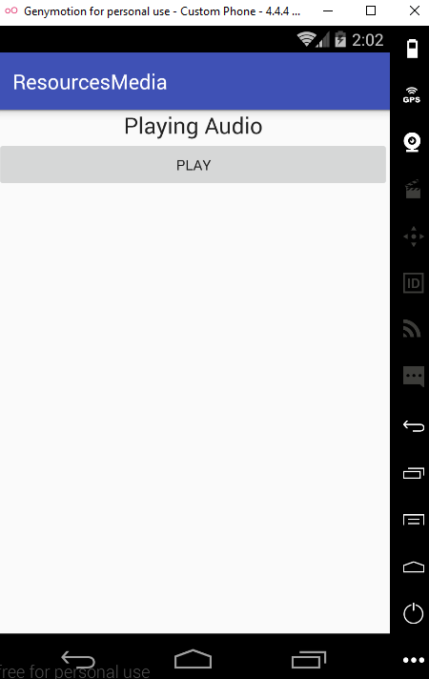
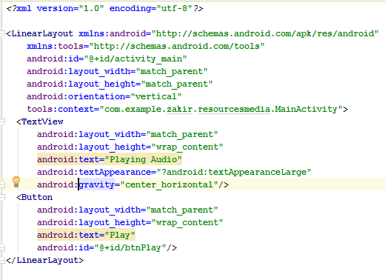
XML Code and Java code

Slide 28



We want to be Pause when click on Stop Button and should Start when click on Play button.

Slide 29
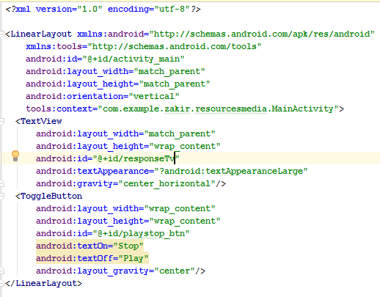

Java and Xml Code

Slide 30
Playing Video
To Play Video in an application, Android Provides a VideoView control, which along with the MediaController, provides several buttons for controlling video play.
These buttons allow us to play, pause, rewind and fast-forward the video content displayed via the VideoView control.

Slide 31


Java and XML Code

Slide 32

Displaying Progress with ProgressBar
Certain task, such as downloading a file, installing software, executing complex queries and playing audio and video take time to execute
While executing such tasks we need to continuously inform the user about the task progress by displaying a progress indicator.
The ProgressBar is a control commonly used for displaying the progress of execution of task.
The default ProgressBar view is circular indicator
Widget.ProgressBar.Horizontal
Widget.ProgressBar.Small
Widget.ProgressBar.Large
Widget.ProgressBar.Inverse
Widget.ProgressBar.Small.Inverse
Widget.ProgressBar.Large.Inverse

Slide 33


Layout of ProgressBar

Slide 34



XML and Java Code

